Slide 1
Music Store Data Analysis
Insights Derived from SQL Analysis
Arif Amin

Slide 2
CONTENTS
Introduction
Data Preparation
Objective
Methodology.
Employee Analysis
Sales/Revenue Analysis
Customer Analysis
Music Analysis
Challenges and Learnings
Recommendations/Insightful suggestions

Slide 3
Introduction
Project Overview:
This project involves analyzing a music store's data using SQL to derive meaningful
insights that can enhance business decision-making.
By performing SQL analysis on this data, we aim to explore key aspects of the
store’s performance, including sales trends, customer loyalty, and geographic
distribution of sales.

Slide 4
Data Preparation
Dataset Overview:
Tables analyzed: artist, employee,invoice,customer, etc.
This dataset comprises of ten tables ; album,artist,customer ,employee, genre, invoice, invoice line, media
type, playlist-track and track.
Steps Taken:
Imported data into the SQL database.
Explored relationships between tables.
Cleaned and prepared data for queries by removing the special characters and adding null values for blank
values.
Total of 59 customers, 275 artists, 3503 tracks, 347 albums ,9 employees and 614 invoices have been
included in the data.

Slide 5
Objective
The primary goal of this SQL-based data analysis is to uncover insights that can help improve the music store’s
overall operations, customer engagement, and sales performance by utilizing SQL functions and then visualize
the findings using various charts.
Key Areas of Focus
Customer Analysis: Understanding customer preferences (genre, spending habits), Identifying top
customers, and segmenting customers for targeted marketing.
Sales Analysis: Evaluating sales performance across different regions, identifying top-performing invoices,
and analyzing revenue generation.
Employee Analysis: Determining employee seniority.
Music Analysis: Analyzing music genre popularity, artist performance, and track characteristics.

Slide 6
Methodology
Description of SQL functions used –
JOIN: To combine data from two or more tables
DISTINCT: To retrieve unique email ids, first name, last name of customers.
CTE: For creating temporary result sets.
Aggregation Functions: SUM, COUNT,AVERAGE, MAX.
GROUP BY & ORDER BY: For grouping & sorting data.
WINDOW FUNCTION: ROW NUMBER FUNCTION that assigns a unique sequential integer to each row within a partition of a result set.
RECURSIVE FUNCTION: The recursive keyword within a CTE where the second query is dependent on first query.

Slide 7
Employee Analysis

Slide 8

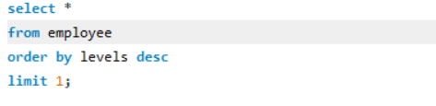
Who is the senior most employee based on job title.
INTERPRETATION:
Adams Andrew
is the senior
most employee
with level 6 (L6).

Slide 9
Sales Analysis

Slide 10
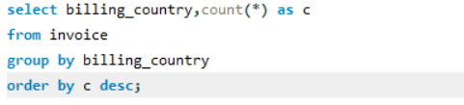
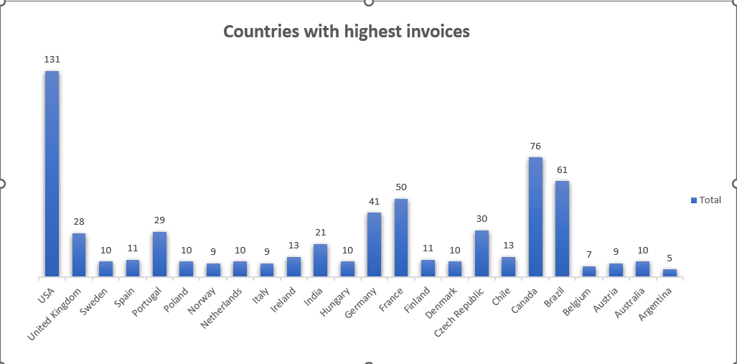
Which Countries have the most invoices
INTERPRETATION:
USA has the highest invoice total of 131.

Slide 11
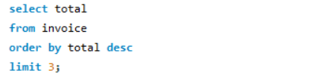
What are top 3 values of total invoice
INTERPRETATION:
The top invoice total value is 23.76, followed by 19.8 twice.

Slide 12
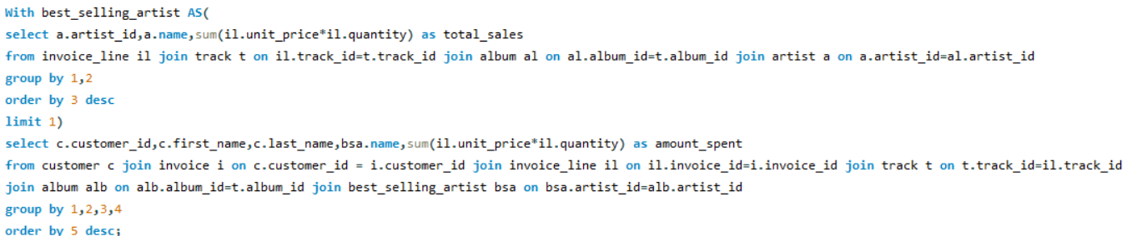
Amount spent by each customer on best selling artists
INTERPRETATION:
Hugh has spent the highest amount
‘28’ on the best selling artist “Queen”.

Slide 13
Customer Analysis

Slide 14
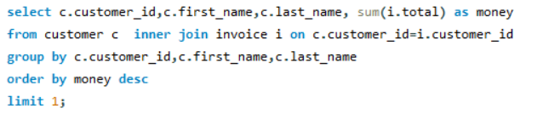

Write a query that returns the person who has spent the most money.
INTERPRETATION:
The customer who has spent the most money is Franteik Wichterlova

Slide 15
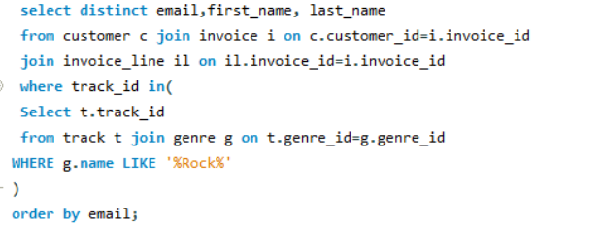
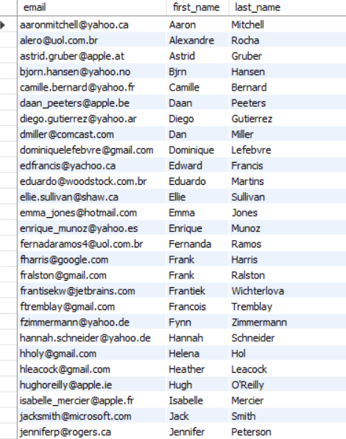
Write a query to return the email, first name, last name, & Genre of all Rock Music listeners. Return your list ordered alphabetically by email starting with A.
INTERPRETATION:
Customers who are rock music listeners are ‘55’ in number.

Slide 16
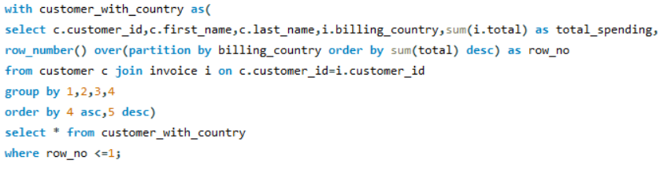
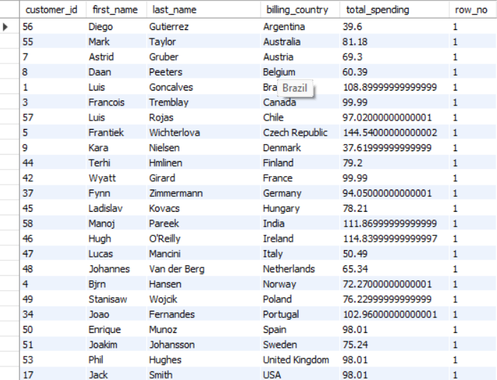
Write a query that returns the country along with the top customer and how much they spent.
INTERPRETATION:
Gives the top customers for each country which are “24” in number

Slide 17
Music Analysis

Slide 18
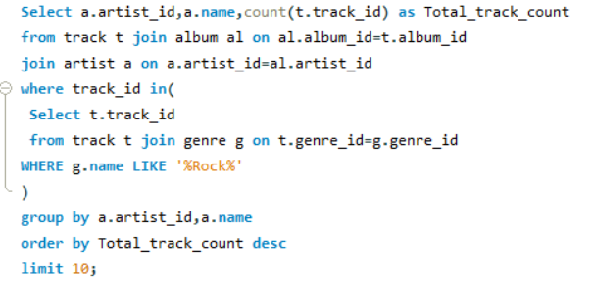
Write a query that returns the Artist name and total track count of the top 10 rock bands.
INTERPRETATION:
Led Zeppelin is the artist with highest track count from Rock genre

Slide 19
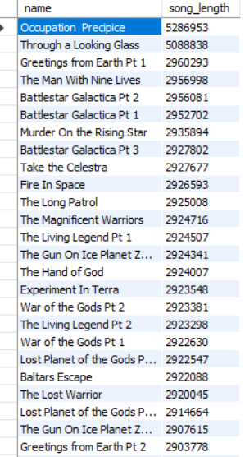
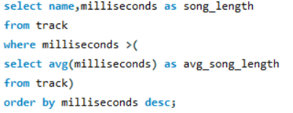
Return all the track names that have a song length longer than the average song length.
INTERPRETATION:
The track names with length greater than average song length(393599.2121) are returned which are “424” in number.

Slide 20
Challenges and Learnings
Challenges faced during analysis:
Understanding complex relationships between tables.
Cleaning and preparing the data.
Key Learnings:
How SQL queries can extract valuable insights.
Importance of exploring and visualizing data.

Slide 21
Recommendations/Insightful suggestions
Customer Engagement and Personalization
Top Spenders & Loyal Customers: Since Frantiek Wichterlova has been identified as the top customer, the store should
create personalized loyalty programs or offer exclusive discounts to such top spenders.
Targeted Genre Promotions: Many customers prefer Rock music. The store could promote rock albums,
host rock- themed events, or offer bundled deals focused on rock music to increase sales in this genre.
Geographic Marketing Strategy
Focus on High-Invoice Countries: Since the USA has the highest number of invoices, the store can
concentrate marketing and promotional campaigns there to maximize Return on Investment (ROI). This could
include regional events, social media campaigns, or localized offers.
Expand to Underperforming Regions: Conduct further analysis to identify underperforming regions or cities
and explore ways to attract new customers there, possibly through partnerships with local artists or record
stores.

Slide 22
Recommendations/Insightful suggestions
Artist and Track-Based Insights
Leverage Popular Artists: Queen has been identified as a best-selling artist. The store could create promotional campaigns,
such as "Artist of the Month" featuring Queen’s albums, exclusive merchandise, or themed playlists to drive further sales.
Highlight Long Tracks: Promote tracks with lengths greater than the average song length, as they may
provide more value to customers who enjoy extended listening experiences.
Improving Employee Effectiveness
Employee Recognition: Highlighting “Adam Andrew “as the senior-most employee (L6) suggests a
structured hierarchy. Recognizing and rewarding experienced employees like Adam can boost morale and
productivity.
Training Programs: Use the experience of senior employees to mentor junior staff and enhance customer
interactions, sales techniques, and product knowledge.

Slide 23

Recommendations/Insightful suggestions
Sales Performance Optimization
Analyze Invoice Trends: Identify the reasons behind the top three invoice values (23.76, 19.8, 19.8) and
explore if similar patterns (product bundles, special deals) can be leveraged to encourage customers to
make higher-value purchases.
By implementing these strategies, the music store can improve its customer
retention, expand its geographic reach, and boost overall revenue.

Slide 24
THANK YOU

